Slide 1
Sample Program
// FileName.cpp
// Written by Max Fomitchev (mif10)
// This is a sample program
//
#include <iostream>
using namespace std;
void main()
{
}

Slide 2
Character Strings
// Never hard code constants
// Use macro declarations instead
#define MAX_LENGTH 255
// String of 255 ASCII characters (char-array)
char email[MAX_LENGTH];
// Uninitialized string (pointer)
char* anotherEmail;
// Single character
char aCharacter;
email[0] – first character
email[i] – i^{th} character
email[MAX_LENGTH-1] – last character;
character string arrays are zero-terminated!
char* name = “MAX”;
[‘M’ ‘A’ ‘X’ ‘\0’]
[0 1 2 3 ]
‘\0’ is equivalent to 0, however ‘\0’ should be used with strings.

Slide 3
string class (STL)
#include <string>

Slide 4
Project, Source Code Organization
Read Chapter 8 from “Enterprise Application Development with Visual C++ 2005”
* Simplicity * Clarity * Discipline
Name your project in a meaningful way (e.g. EmailChecker, not test1 or assignment1)
Comment your code! Add a header describing each file.

Slide 5
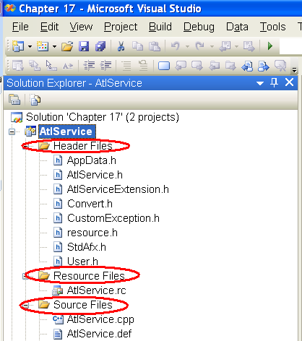
Project Structure

Slide 6
Visual Studio Solutions
Visual Studio solution provides a way to organize projects by grouping them together.
Create a solution and call it Labs.
Add all your lab projects to this solution.
Make sure that your project files reside in a single location, which in with in the main solution foldr.

Slide 7
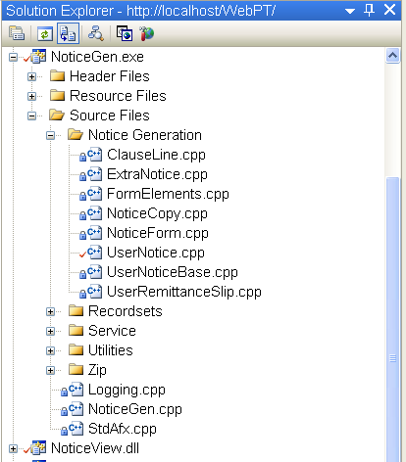
Project Structure

Slide 8
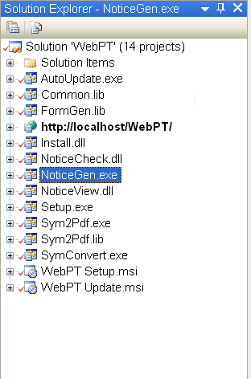
Solution Structure

Slide 9
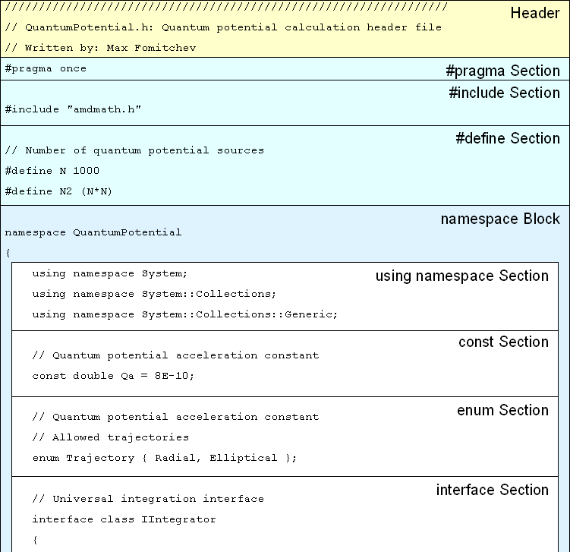
Header File Structure

Slide 10
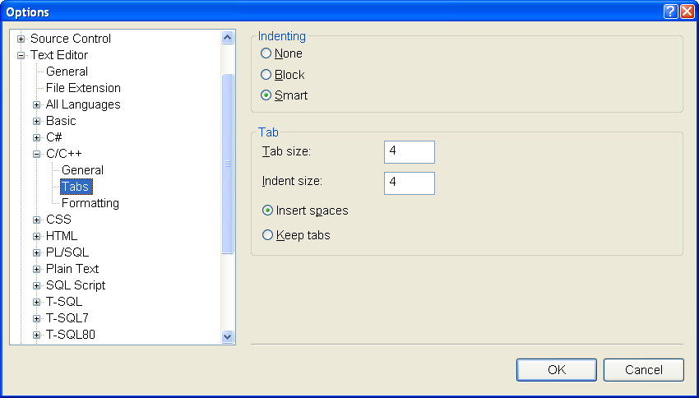
Spaces, Not Tabs

Slide 11
Code Formatting
General Rules: White Space and Comment Placement
When used consistently white space can greatly enhance the appearance of your source and facilitate recognition and comprehension of the coded logic. To achieve optimal appearance follow these rules when writing your code.
Always Indent Your Code!

Slide 12
Function Parameters
Insert a Single Space Between Function / Method Arguments
Use spaces to separate function arguments for improved readability, e.g.:
// Good
DoSomething(a, b, c);
// Bad
DoSomething(a,b,c);

Slide 13
If, for, while
Use a Single Spade Before and After Parenthesis in for, if, while and switch Statements
Use spaces to separate arguments of statements requiring arguments in parenthesis:
// Good
if ( a ) …
for ( int i = 0; i < count; i++ ) …
while ( a ) …
switch ( a ) …
// Bad
if(a) …
for(int i = 0; i < count; i++) …
while(a) …
switch(a) …

Slide 14
Operators
Insert a Single Space Between Operator Arguments
Use spaces to separate operator arguments for improved readability, e.g.:
// Good
a = b + c - d;
// Bad
a=b+c-d;
Exception: Arguments of operators depending higher degree of precedence (such as * and / operators) should be placed without spaces in order to provide visual indication of seniority and therefore order of operators in expression, e.g.:
// Good
a = b*c + d/e;
// Bad
a = b * c + d / e;

Slide 15
Logical Expressions
Use Parenthesis for Explicit Grouping in Logical Expressions
Order of operations in logical expressions is a frequent source of errors due to confusion over precedence of operations. Explicit grouping of operations in logical expressions by means of parenthesis will help you avoid such errors, e.g.:
if ( (a || b) && (c || d) ) …
// Good
a = (b == c);
a = (b < c);
// Bad
a = b == c;
a = b < c;

